Slide 1
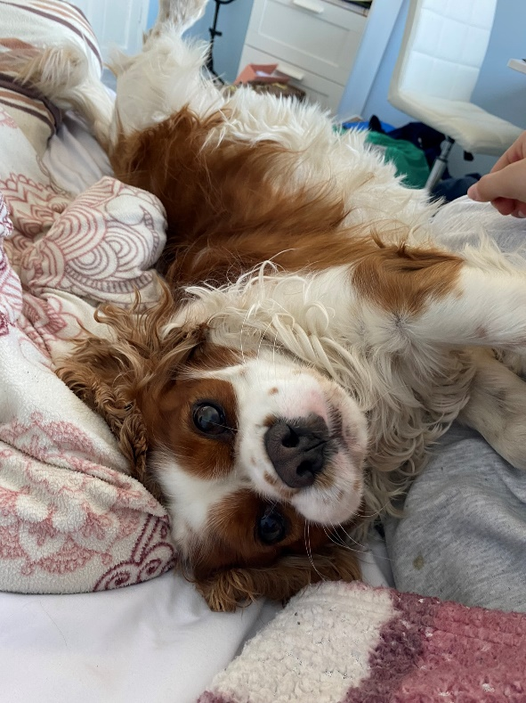



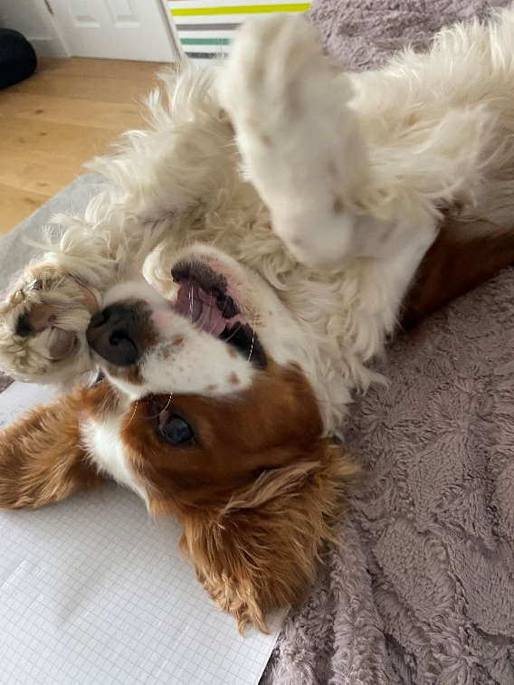
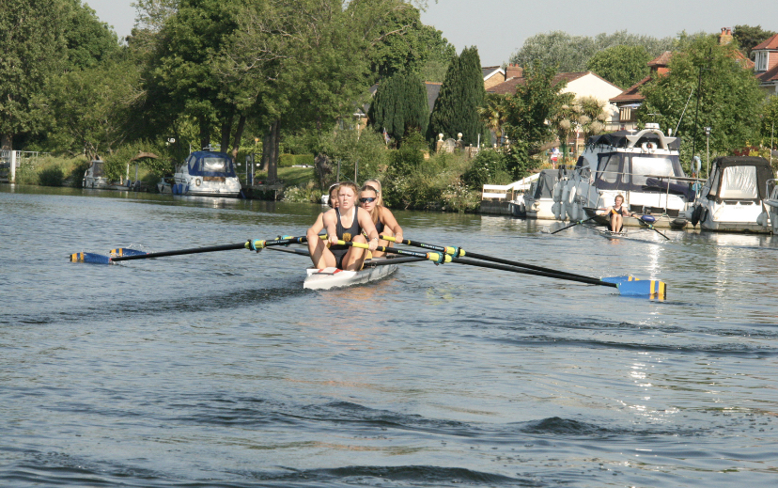


Charlize Butcher
Rowing
Lennie
Sailing

Slide 2
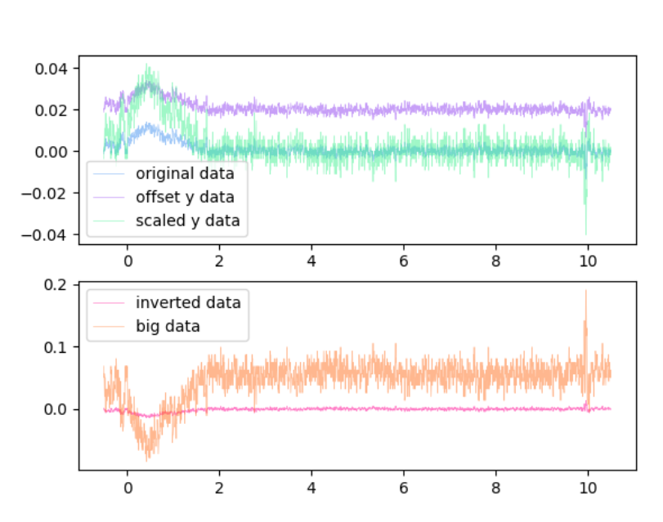
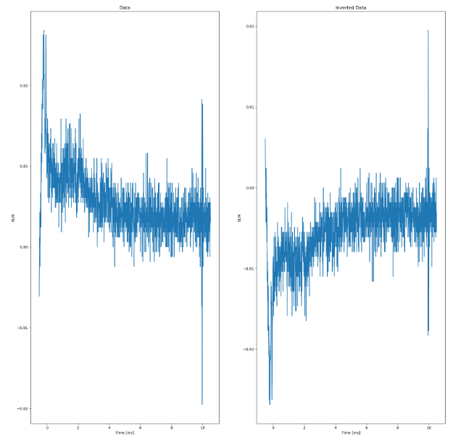
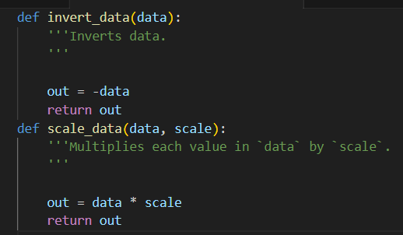
What I’ve learnt
Prior coding experience:
-Very limited
-Therefore this was a massive learning experience – lots of learning on the job
What I learnt in Project 1:
Data Filter Group
Created function
Learnt how to use GitLab
Learnt about classes
Matplot lib and coding graphs

Slide 3
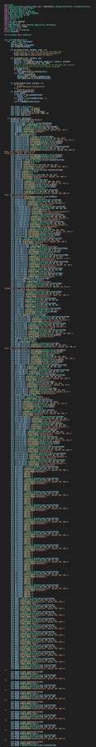
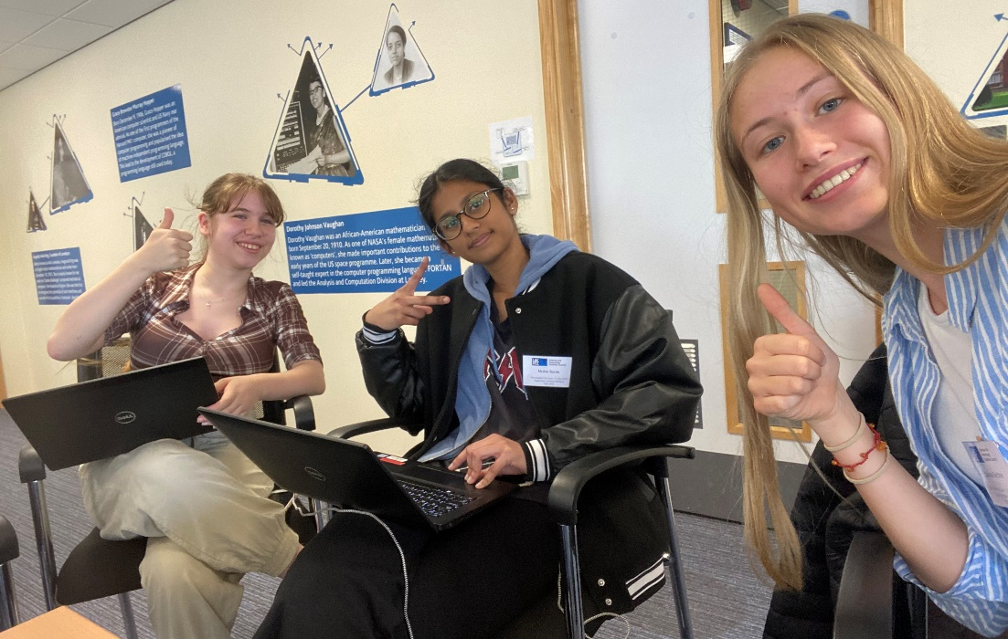
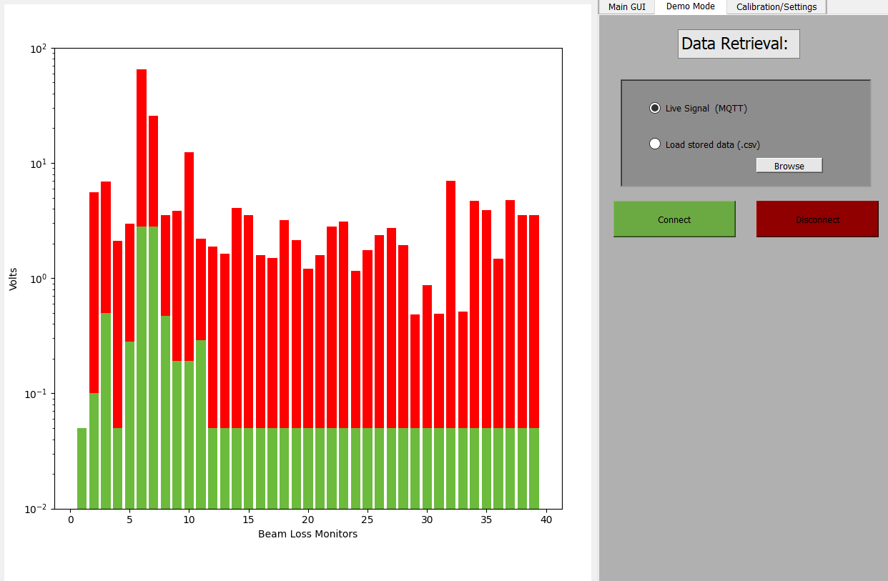
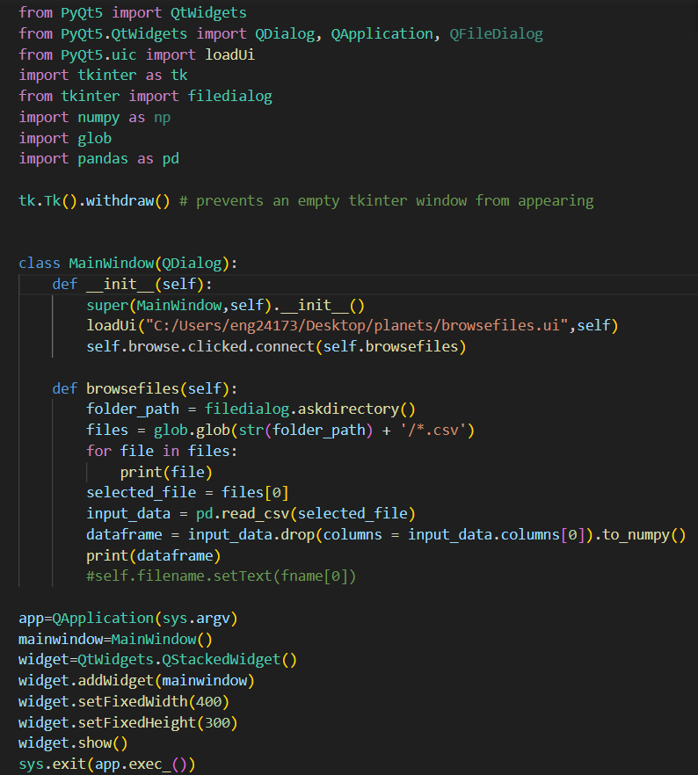
What I’ve learnt
What I’ve learnt in project 2:
PyQt, mqtt
Designing the GUI with Mukta
Learning how to program the widgets to make them work
planning

